Slide 1
Operating systems
Lecture #2

Slide 2
Content Lecture#2
01
Interrupts – hardware, software, and exception
02
Process
03
Concept of Process
04
Operations on Process
05
Process creation & termination
06
Process Control Block
07
Process Table
08
Process State &Process State Transition
09
Process Context Switch
10
Zombie and Orphan Process

Slide 3
Lets take a Break
where Saint Peter gives him a nice, modern six-bedroom house with a pretty garden and a tennis court. Pleased with his lot, Bill quickly settles into the afterlife. One day he is out walking when he bumps into a man wearing a fine tailored suit. "That's really nice," says Bill. "Where did you get it?" "Actually," says the man, "I was given 50 of these, plus two mansions, a yacht, a golf course and four Rolls-Royces." "Wow, were you a pope or a doctor healing the terminally ill?" asks Bill. "No, I was the captain of the Titanic." Bill storms off to see Saint Peter. "How come the captain of a sunken ship gets all that while I, the inventor of the Windows Operating System gets a crummy little house?" he asks. Saint Peter replies, "The Titanic only crashed once."

Slide 4
Interrupts
An interrupt is a signal emitted by a device attached to a computer or from a program within the computer. It requires the operating system (OS) to stop and figure out what to do next.
Process
A process is a program in execution.

Slide 5
Interrupts
Mechanism by which Programs/hardware like I/O devices, memory modules may interrupt the normal processing of the processor
Interrupts are generated by various agents to notify the OS of the occurrence of some event
such as completion of an I/O activity
When an interrupt occurs, the execution flow of processor is diverted into specific part of OS code which deals with the event – interrupt handler
Interrupts are used to permit several programs and I/O activities to process independently and asynchronously
Hence improve the processing speed
Advantages
It provides a low overheads means of gaining the attention of the CPU
Interrupt Vector Table is a location near the bottom of memory contains the address of interrupt services procedures of I/O devices
As each instruction terminates, the processor may checks for the occurrence of interrupts
If an interrupt received, the actual program is temporarily suspended, and the processor is diverted to interrupt handling routine
When the interrupt is served, the execution will return to the interrupted program

Slide 6
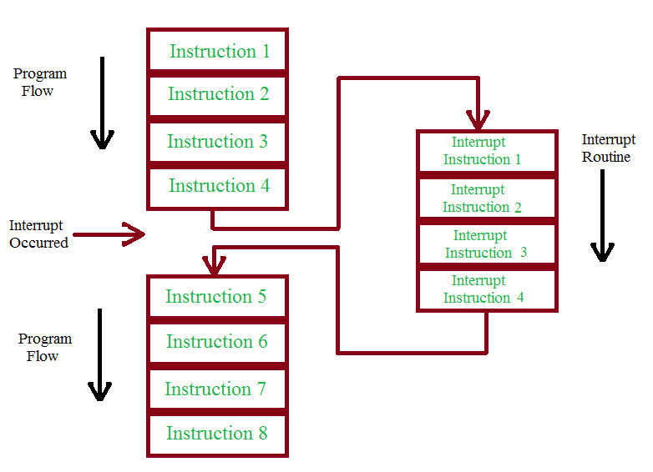
Interrupt Processing
Following events occurs in processor hardware and software due to an I/O interrupt
The device issue an interrupt signal to processor
The processor finishes execution of current instruction, saves states of interrupted process before responding to the interrupt
The processor sends an acknowledgment signal to the device that issued the interrupt and device remove its interrupt signal/flag
Processor transfer control to the appropriate interrupt handler routine and it starts processing interrupt
When the interrupt id served, the state of interrupted process is restored
Next process starts execution
Interrupt Service Routine
For every interrupt, there must be an interrupt service routine (ISR), or interrupt handler. When an interrupt occurs, the microcontroller runs the interrupt service routine. For every interrupt, there is a fixed location in memory that holds the address of its interrupt service routine, ISR. The table of memory locations set aside to hold the addresses of ISRs is called as the Interrupt Vector Table.

Slide 7
Types of Interrupts
Interrupts are categorized in following
Hardware Interrupts
Software interrupts
Exception
Interrupts may be generated by a number of sources, which are following
I/O: Generated by I/O device controller, to signal normal completion of event or the occurrence of an error or failure condition
Time: Generated by an internal clock within the processor due to expiration of a process’s time quantum or receipt of a signal from another processor on a multiprocessor system
Hardware error: Generated by hardware faults such as power failure
Exception
Trap: control returns to the next instruction which caused interrupts
Fault: Control returns to the same instruction which caused interrupts
Double Fault Exception within Exception
Program: Generated in a user program as a result of instruction execution, such as;
Arithmetic overflow
Divide by zero
Attempt to execute an illegal machine instruction
Reference out side a user allowed memory space

Slide 8
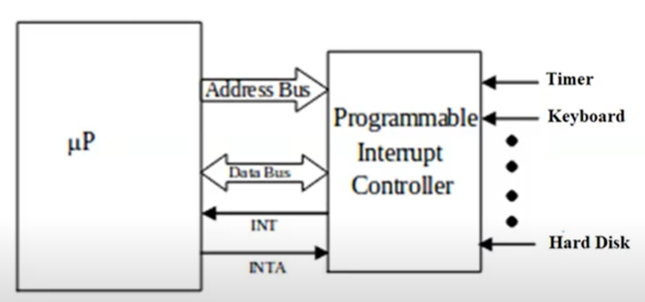
How Hardware interrupts are generated

Slide 9
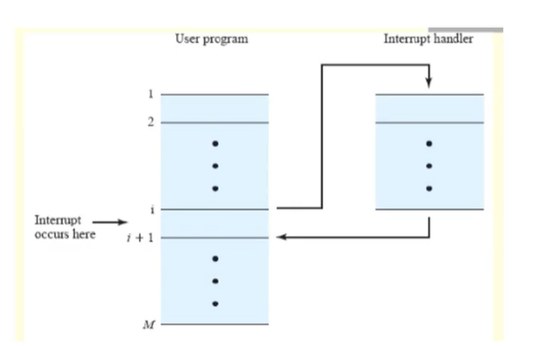
How Software interrupts are generated
Application Programming Interface (API)

Slide 10
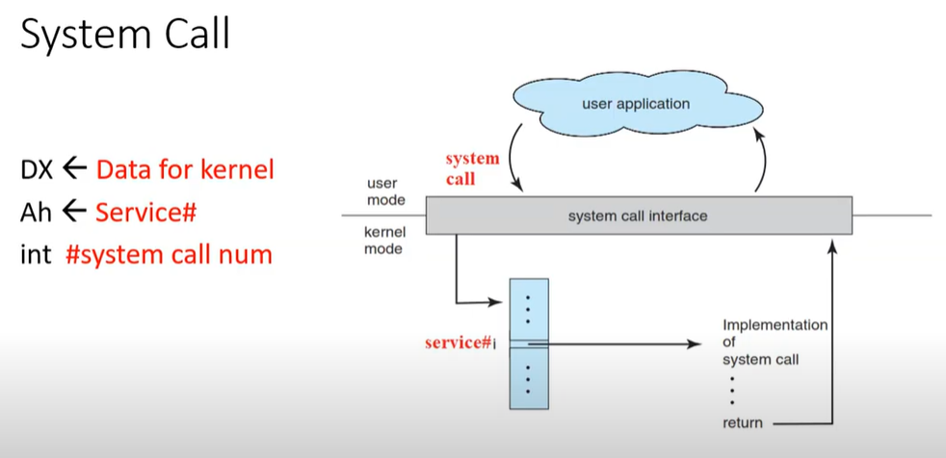
System Call &API
Application Programming Interface (API)
DX<- Data for Kernel
Ah <- Service#
Int #num

Slide 11
Process
A process is basically a program in execution
or that which a processor executes
A process is unit of work in a system
A process is an activity performed by a system
It may be program’s data, program counter, pointer or register used in a program
A process uses resources like CPU, memory, files and I/O devices
Operating system processes execute system code and user processes executes user code

Slide 12
Program VS Process
A program is a passive entity
A process is a dynamic entity represented by the values stored in registers, memory, program counters etc.
A program does not compete for the computing resources whereas a process does
One program can have several processes
Consider multiple users executing the same program

Slide 13
Process Concept
Process idea was first used in Multics
All programming OS, such as Windows NT, or MVS (multiple virtual storage) were built around the concept of process
Major requirements that the OS must meet can all be expressed with reference to process
OS must interleave the execution of a number of processes to maximize processor use
OS must allocate resources to process in confirming to a specify policy
e.g. certain functions or applications are of higher priority
at the same time avoiding deadlock
OS may support inter-process communication

Slide 14
Program
Code Segment
One of the sections of a program in an object file or in memory, which contains executable instructions.
Data Segment
A data segment is a portion of the virtual address space of a program, which contains the global variables and static variables that are initialized by the programmer.
BSS(block started by symbol)
Data in this segment is initialized by the kernel to arithmetic 0 before the program starts executing
uninitialized data starts at the end of the data segment and contains all global variables and static variables that are initialized to zero or do not have explicit initialization in source code..
C++ Program
#include <iostream>
using namespace std;
int a=10;
int b=5;
main()
{
// Write C++ code here
int c;
c=a+b;
cout << "Hello world!\n\n";
cout << c; return 0;
}
BSS
Data Segment
Structure of Binary file
Executable instruction
Globally initialized variable
Uninitialized Global variable
Local initialized variable
Local Uninitialized variable
Code Segment
Globally initialized variable are kept in data segment
Uninitialized Global variable are kept in BSS
Local variables are kept in code segment as part of instruction for a program

Slide 15
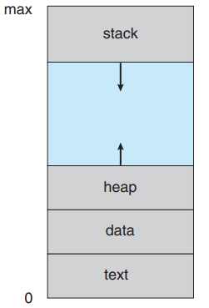
Process
Heap
is memory that is dynamically allocated during process run time. The heap segment contains dynamically allocated memory, commonly begins at the end of the BSS segment and grows to larger addresses from there. It is managed by malloc, calloc, realloc, and free, which may use the brk and sbrk system calls to adjust its size. The heap segment is shared by all threads, shared libraries, and dynamically loaded modules in a process.
Stack
A process generally includes the process stack, which contains temporary data (such as function parameters, return addresses, and local variables), The stack area traditionally adjoined the heap area and grew in the opposite direction. The stack area contains the program stack, a LIFO structure, typically located in the higher parts of memory. The set of values pushed for one function call is termed a “stack frame”
Stack
Heap
Data Segment
Code Segment
Local uninitialized or uninitialized variables are kept in stack until function returns

Slide 16
Activity
You have an array of 1000 elements and you need to search a number from it.
2 core available or 4 core available
Parallel processing can be achieved if a programmer speed up the performance by assigning a part of program to each core
For a single processor
Multitasking
Divide single program in multiple process and assign it to more time slice and time is assigned more to a single process

Slide 17
Operation on process
A system managing processes may perform following operations
Create a process
Destroy a process
Suspend a process
Resume a process
Block a process
Wakeup a process
Dispatch a process
Change process’s priority
Enable a process to communicate with other processes
For long term suspension, process’s resources should be free
Changing the priority of process normally involved modifying the priority value in PCB

Slide 18
Process creation & termination
A process may create other processes
When a process creates a new process
The creator process is called the parent process
Created process is called the child process
Act of creating a process is called spawning a process
A child process may share the resources of its parent process
A parent may wait for its child process to terminate before resuming or may run concurrently with the child process
A child process may run the same program as that of its parent or may run a separate program
In DOS, parent and child process do not run in parallel and parent process will suspend itself till child has finished

Slide 19
Process creation & termination
When a process is created the following operations are performed
Process naming (process id)
Creates the process control block
Insert it in process table
Determine the process initial priority
Allocate the process’s initial resources
Allocate the address space to be used by the process
When a process is destroyed following operations are performed
Its resources are returned to the system
Its process control block is erased
It is purged from any system list or table

Slide 20
Reason: Process creation & termination
Reason of Creation
New batch job
In a batch environment, a process is created in response to the submission of a job
Interactive log on
A user at a terminal logs on to the system
Created by OS to provide a service
OS can create a process to perform a function on behalf of a user program, without user having to wait, e.g. printing
Spawned by existing process
A user program can create a number of processes
Typically related processes need to communicate and cooperate each other
Achieving this cooperation is a difficult task for the programmer of OS

Slide 21
Reason: Process creation & termination
Reason of termination
There must be some means for a process to indicate its completion
A batch job should include a halt instruction, which generates an interrupts to alert the OS that a process has completed
For an interactive application, the action of the user will indicate whether the process is completed

Slide 22
Reason: Process creation & termination
Following are the possible reasons for process termination;
Normal termination :The process executes an OS service call to indicate that it has completed running
Time limit exceeds: The process has run longer than the specified total time limit which includes
total time elapsed , amount of time spent executing ,
in case of interactive process, he amount of time since the user last provided any input
Memory unavailable: The process requires more memory than the system can provide
Bounds violation: The process tries to access the memory locations that is not allowed to access
Protection error: The process attempt to use a file that is not allowed to use or, It tries to use it in improper fashion, such as writing to a read only file
Arithmetic error: The process tries a prohibited computation such as division by zero
Time overrun: The process has waited longer than specified maximum for a certain events to occur

Slide 23
Reason: Process creation & termination
I/O failure: An error occur in input or output, such as
inability to find a file
failure to read a write after a specified maximum no of tries (when, e.g. a defective area is encountered on a diskette) or
invalid operation (such as reading from the line printer)
Invalid instruction: The process attempts to execute a non-existent instruction (often a result of branching into a data area and attempting to execute data)
Privileged instruction: The process attempts to use an instruction reserved for the operating system
Data misuse: A piece of data is of the wrong type or is not initialized
OS or operator intervention: For some reason, the operator or the OS has terminated the process (e.g. if a deadlock exists)
Parent termination: When a parent terminates, the OS should be design to automatically terminate all the offspring of that parent
Parent request: A parent process typically has the authority to terminate any of its offspring

Slide 24
Process Control Block
Each process is represented in the operating system by a process control block (PCB)—also called a task control block.
When a new user program is initiated
OS creates a data structure, called Process Control Block (PCB), which gives substance to the process and serves to control it
Each process is represented by its own process control block
PCB is a data block or record containing information associated with a specified process
Allows the OS to locate all key information about a process
When the OS switches the attention of the CPU among various active processes
It uses the same area in PCB to hold the information
That information used to restart process when the process next gets CPU
Process control block is also called task control block

Slide 25
Process Control Block
PCB contains following information about process
Current state of the process
Unique identification of process
A pointer to process parent
Pointer to process’s child processes
The process’s priority
Pointer to locate the process memory
Pointer to allocate resources
The register save area – CPU register
The processor it is running on
Accounting information
I/O state information
Pointer | Process state
Process number
Program counter
Registers
Memory limits
List of open files
. . .

Slide 26
Process Table
OS maintains the process table with one entry per process
This entry contains information about process’s
state
its program counter
stack pointer
memory allocation
the status of its open file
its accounting and scheduling information
its priority

Slide 27
Process State
As a process executes, it changes state. The state of a process is defined in part by the current activity of that process. A process may be in one of the following states:
New. The process is being created.
Running. Instructions are being executed.
Waiting. The process is waiting for some event to occur (such as an I/O completion or reception of a signal).
Ready. The process is waiting to be assigned to a processor.
Terminated. The process has finished execution.

Slide 28
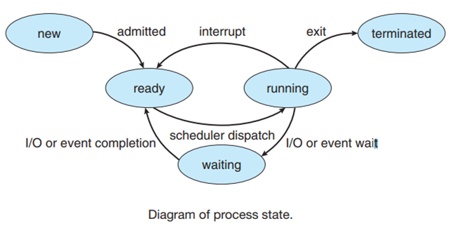
Process State
These names are arbitrary, and they vary across operating systems. The states that they represent are found on all systems, however. Certain operating systems also more finely delineate process states. It is important to realize that only one process can be running on any processor at any instant. Many processes may be ready and waiting, however. The state diagram corresponding to these states is presented in Figure

Slide 29
Process State Transitions
Transition-1:
Occurs when a process cannot continue may be due to I/O request
Transition-2:
Request when scheduler decides that the running process has run long enough , and it’s the time to give CPU to other processes in ready state
Transition-3:
Occurs when all the other process have had their CPU time and its time for the first process to run again
Transition-4:
Occurs when external event for which process was waiting happens. If no other process is running at that time, transition-3 will be triggered and the process will start execution

Slide 30
Process State Transitions
Ready
4
Blocked
3
2
1
Running
The four transitions can be indicated as follows
Block running → block
Timerunout running → ready
Dispatch ready → running
Wakeup block → ready

Slide 31
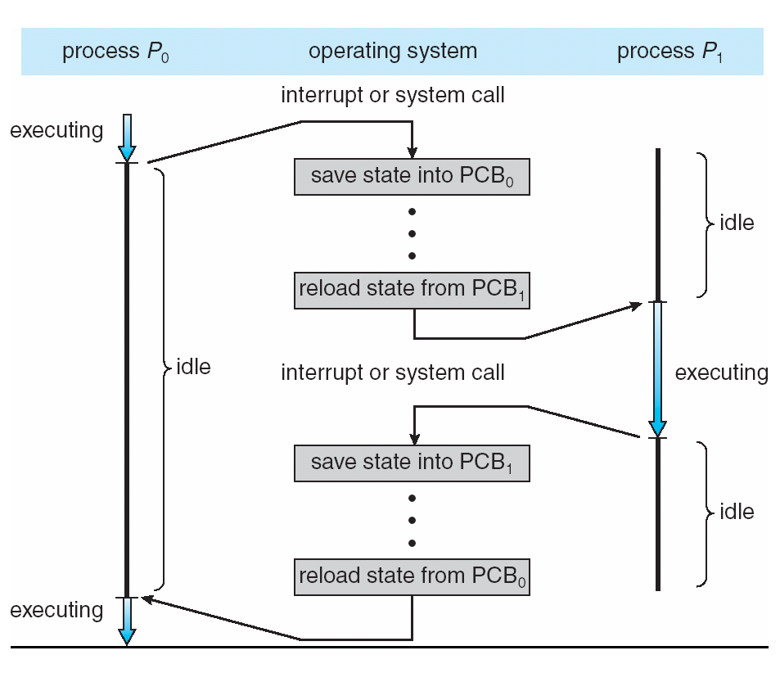
Context Switch
Context switching is the procedure of switching of process from processor to memory and vice versa in a multiprogramming environment
When CPU switches to another process
The system must save the state of the old process
Load the saved state of the new process
Context switch involves storing and loading the values of each of the process’s control block, and process registers, such as;
The program counter
Index register
General register
Stack pointer etc
Context switch is pure overhead
The system does no useful work while switching
Context switch time depends on hardware support e.g, memory speed, the number of registers etc.
Its range is from 1 to 100 microsecond
This speed vary from system to system

Slide 32
Zombie or Orphan Process
Immediate Parent process terminates before child process the process is called orphan process and it is adopted by the init process.
Child process terminates before wait call of parent process is called Zombie Process. Child process terminated but id remains in process table till the wait call.
And when zombie terminates before wait call of parent in this case init process terminate zombie
Process table contain entry of the process but the process is terminated this is Zombie

Slide 33
Create Process
#include <stdio.h>
#include <unistd.h>
#include <sys/wait.h>
int main()
{
pid_t pid; /* fork a child process */
pid = fork();
if (pid < 0)
{ /* error occurred */
fprintf(stderr, "Fork Failed");
return 1;
}
else if (pid == 0) { /* child process */
execlp("/bin/ls","ls",NULL);
}else { /* parent process *//* parent will wait for the child to complete */wait(NULL)
;printf("Child Complete");
}return 0;
}
#include <stdio.h>
#include <unistd.h>
#include <sys/types.h>
int main()
{
printf(" Hello\n");
fork();
printf("world\n");
}
Negative Value: creation of a child process was unsuccessful. Zero: Returned to the newly created child process. Positive value: Returned to parent or caller. The value contains process ID of newly created child process.

Slide 34
Create Process
#include <stdio.h>
#include <unistd.h>
#include <sys/types.h>
int main()
{
int v=5;
if(fork()==0)
{
v++;
printf("Value of V in chilf is %d \n",v);
return 0;
}
else
{
v--;
printf("Value of V is Parent is %d \n",v);
return 0;
}
}
Parent: got its own definition with v=5
Child: got its own definition with v=5
Sot the output will be 4 and 6

Slide 35
Create Process
#include<stdio.h>
#include<sys/wait.h>
#include<unistd.h>
#include<stdlib.h>
int main()
{
int *v =(int*)malloc(sizeof(int));
*v=100;
if(fork()==1)
{
(*v)++;
printf("value of v is the child process is %d \n",*v);
return 0;
}
else
{
(*v)--;
printf("value of v is the child process is %d \n",*v);
return 0;
}
}
malloc: reserve memory on heap

Slide 36
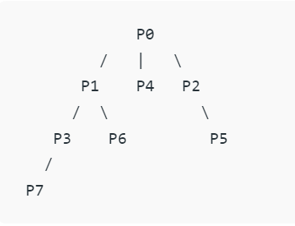
Create Process
#include <stdio.h>
#include <stdlib.h>
#include <sys/types.h>
#include <sys/wait.h>
#include <unistd.h>
int main(void) {
pid_t pid = fork();
if(pid == 0) {
printf("Child => PPID: %d PID: %d\n", getppid(), getpid());
exit(EXIT_SUCCESS);
}
else if(pid > 0) {
printf("Parent => PID: %d\n", getpid());
printf("Waiting for child process to finish.\n");
wait(NULL);
printf("Child process finished.\n");
}
else {
printf("Unable to create child process.\n");
}
return EXIT_SUCCESS;
}
#include <stdio.h>
#include <unistd.h>
#include <sys/types.h>
int main()
{
printf(" Hello\n");
pid_t pid = fork();
printf("World",getppid(), getpid());
fork();
printf("Child => PPID: %d PID: %d\n", getppid(), getpid());
}

Slide 37
Create Process
A call to wait() blocks the calling process until one of its child processes exits or a signal is received. After child process terminates, parent continues its execution after wait system call instruction. Child process may terminate due to any of these:
It calls exit();
It returns (an int) from main
It receives a signal (from the OS or another process) whose default action is to terminate.

Slide 38
Lab
Run a program for adding 2 numbers and define the concept of Program and Process
Create a Process with Fork()

Slide 39
Thank you

